Slide 1
Pervasive Computing and Mobile App Development
THANK
YOU
Notes:
<a href="https://www.freepik.com/free-photos-vectors/business">Business vector created by freepik - www.freepik.com</a>

Slide 2

Submitted by:
Submitted to :
Tanvirul Islam
Department of CSE
Daffodil International University
Abu Sayed Rasel
ID : 191-15-12886
Taranga Saha Sejuti
ID : 191-15-12412
Arif Hossain
ID : 191-15-12447
Nimor Rahman Shawon
ID : 191-15-12734

Slide 3
Maple Student Registration

Slide 4
Our Features
Home
Sign In
App
Sign Up
List
User Profile

Slide 5
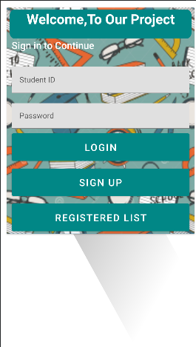
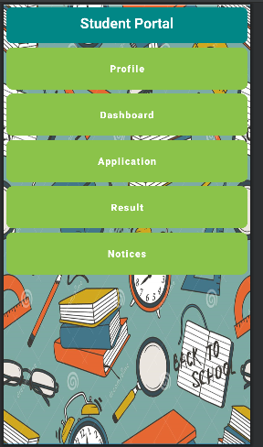
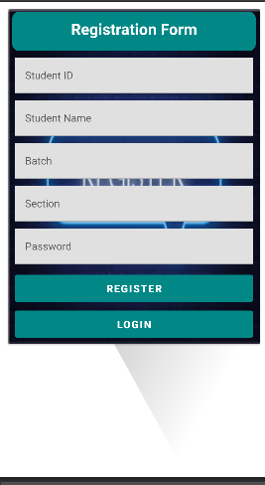
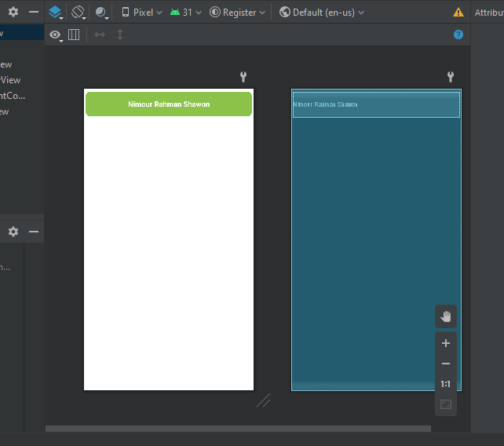
Our Design
Notes:
<a href="https://www.freepik.com/free-photos-vectors/business">Business vector created by freepik - www.freepik.com</a>

Slide 6
APPLICATION ADVANTANGE
Can easily signup and login
User can see his registration successfully or unsuccessfully
Budget friendly
Create individual profile and include application, result, notice and dashboard
Notes:
<a href="https://www.freepik.com/free-photos-vectors/mockup">Mockup vector created by freepik - www.freepik.com</a>

Slide 7
APPLICATION DISADVANTANGE
ERROR
Security system is weak
If we store lots of data sometimes default value come
We face Buffering issues
Notes:
<a href="https://www.freepik.com/free-photos-vectors/mockup">Mockup vector created by freepik - www.freepik.com</a>

Slide 8
Motivation
< /
>
The main intention behind this paper was to design and develop a user-friendly online registration system for the academic usage, which would allow students to assist instructors to keep track of student performance and allows administrators to keep track and manage the student records.
http://
Notes:
<a href="https://www.freepik.com/free-photos-vectors/mockup">Mockup vector created by freepik - www.freepik.com</a>

Slide 9
FUTURE WORK
teacher lecture material upload
solving complicated problem
Updating
Different type of important courses available
teacher also registered
Notes:
<a href="https://www.freepik.com/free-photos-vectors/business">Business vector created by freepik - www.freepik.com</a>

Slide 10
THANK
YOU
Notes:
<a href="https://www.freepik.com/free-photos-vectors/business">Business vector created by freepik - www.freepik.com</a>

